Slide 2

Introduction to Node.js
Welcome!
Tim Kellogg
Senior Instructor, Pluralsight
Notes:
Mandatory
ACTION: Adjust title to fit your course.

Slide 3
Review
What is npm?
What is Express?
Hands-on with Express
Notes:
Mandatory
ACTION: Adjust agenda as per your course.
The agenda provides students a roadmap of where the class is going and what is coming up. Keep it high level, as there is no need to include “Gazornin” in the agenda if that’s something they don’t understand. Refer to the agenda at the beginning of the class, at the end of every day and at the beginning of every morning. In the mornings, the Agenda is a great way to facilitate a Q&A session about what was covered on the previous day.

Slide 4
What is npm?
Npm is the world’s largest software registry and package manager for JavaScript
Used to share and borrow packages, and manage dependencies in projects
Can be used to manage open source software and manage private development

Slide 5
What is Express.js?
Express.js is a web application framework for Node.js, designed for building web applications and APIs
Simplifies the server creation process by providing a robust set of features
Minimal and flexible
Reduces complexity and increases development speed

Slide 6
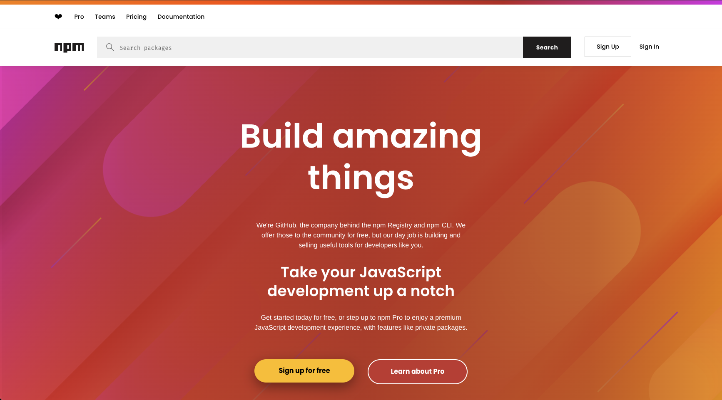
Time to get our hands dirty!

